Slide 1
Housing price prediction
Study of house prices

Slide 2
Problem statement
Houses are one of the necessary need of each and every person around the globe and therefore housing and real estate market is one of the markets which is one of the major contributors in the world’s economy. It is a very large market and there are various companies working in the domain. Data science comes as a very important tool to solve problems in the domain to help the companies increase their overall revenue, profits, improving their marketing strategies and focusing on changing trends in house sales and purchases. Predictive modelling, Market mix modelling, recommendation systems are some of the machine learning techniques used for achieving the business goals for housing companies. Our problem is related to one such housing company.

Slide 3
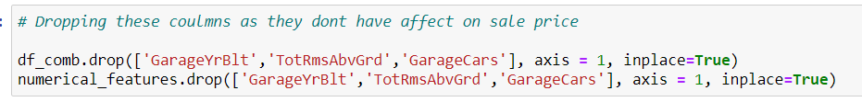
Data cleaning
Deleting of columns which didn’t affect sale price, for e.g. removal of columns in which year garage was built, and cars in garage etc.

Slide 4

Combining the data from test and train dataframe
df contains the training data
df_test contains the testing data
Df_comb contains the combined data from both the dataframes

Slide 5
Assumptions:
Before proceeding with EDA, we have to make some assumptions
As the dataset available to us is only a fraction of the houses sold:
We have to assume that this data set is not biased.
That is, we have to assume that the houses here represent a sort of generalized model of all houses.
We might have, outliers, overfitting and most important of all sampling bias; which we will consider that there is no sampling bias for this project

Slide 6
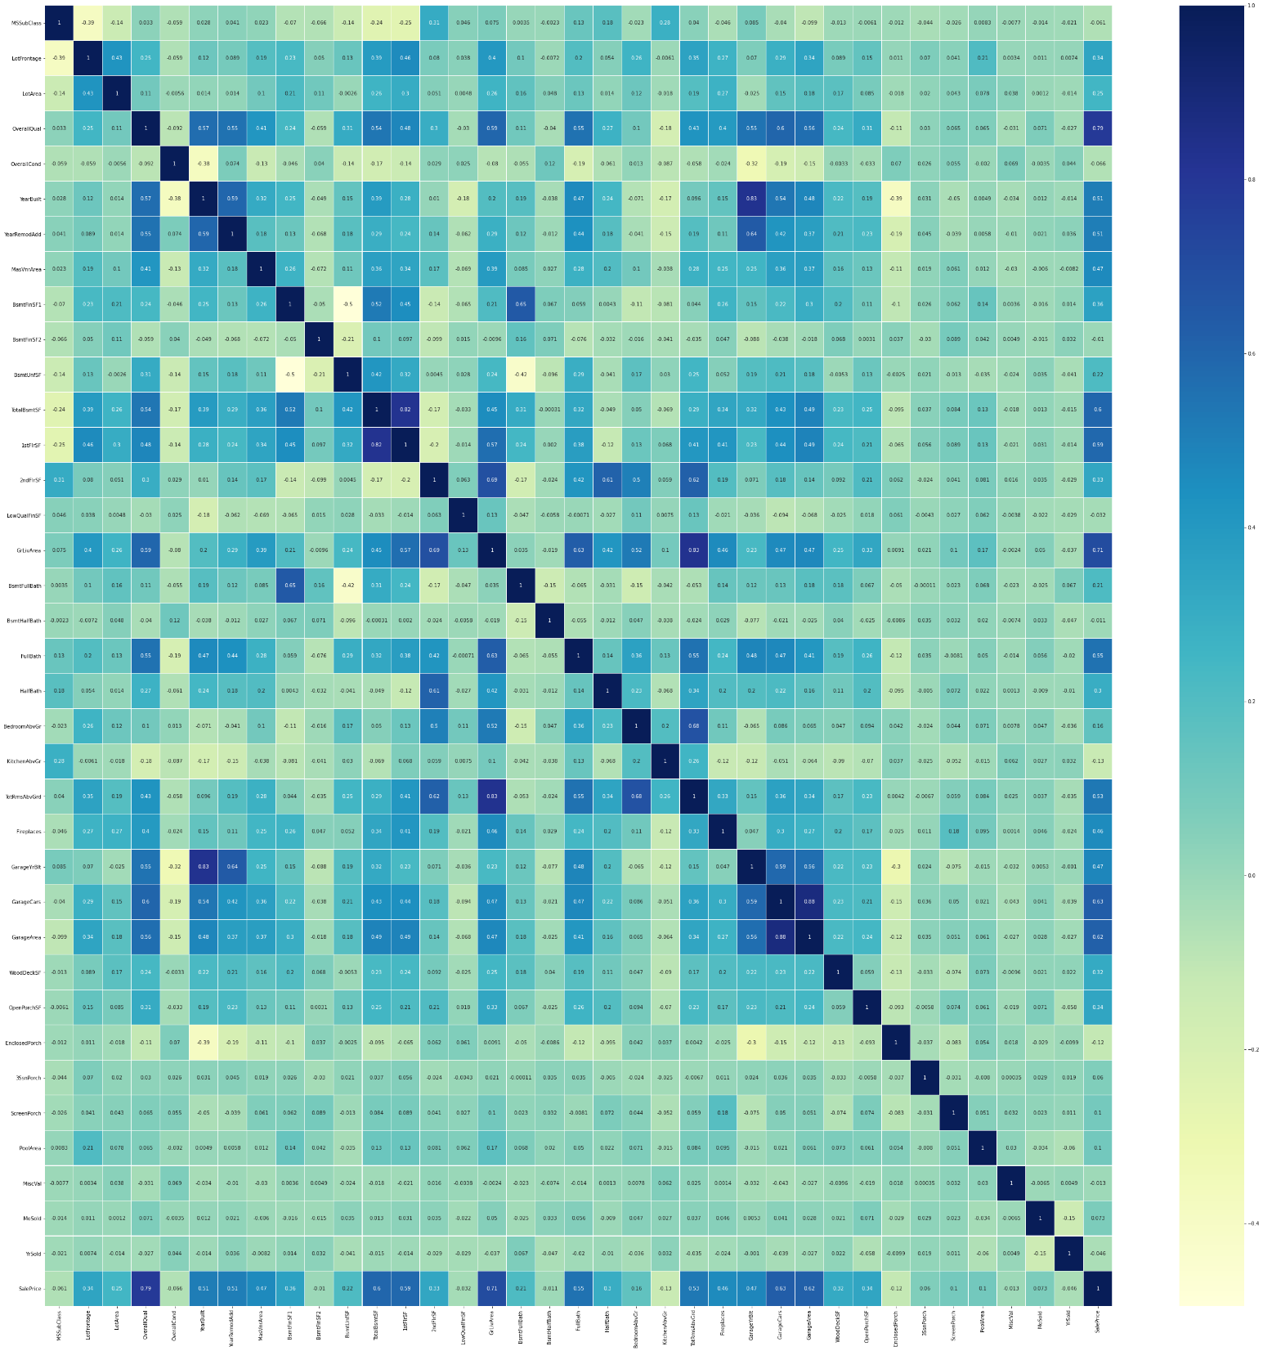
Co-relation matrix
We can see the correlation between all the variables

Slide 7
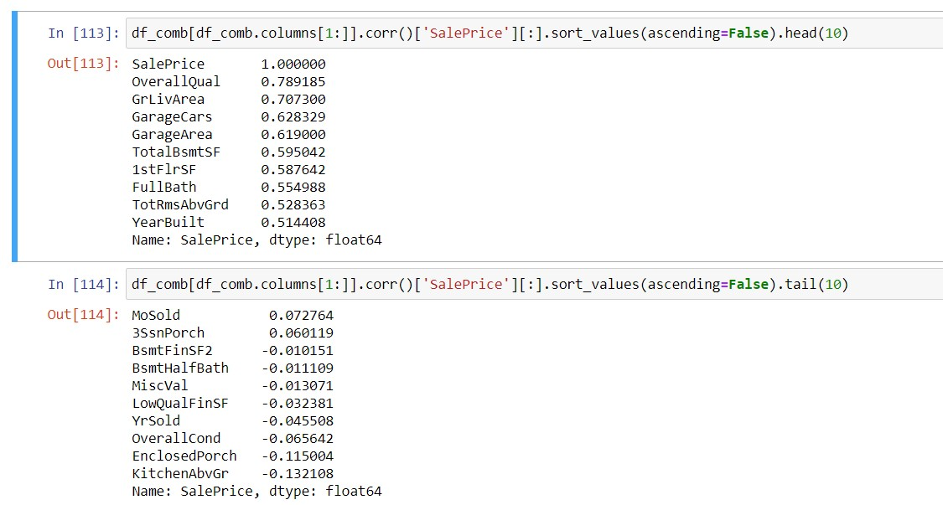
Top 10 best and worst correlated features with target variable

Slide 8
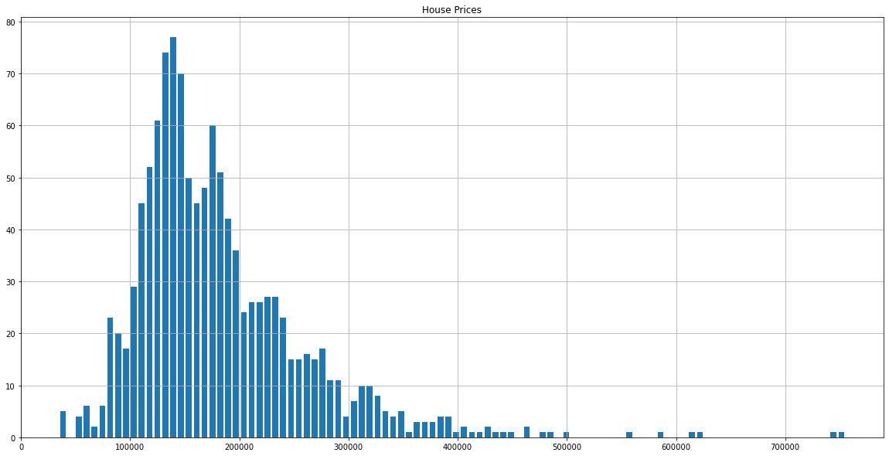
Distribution of sale price
Here we can observer that we have a normal distribution with two peaks, one peak around 125k and another peak around 180k
We can also observe that this distribution is right skewed

Slide 9
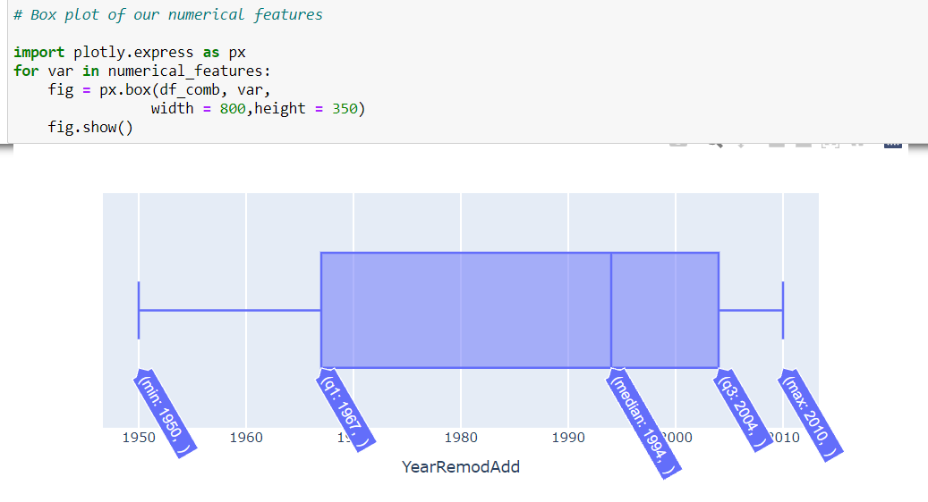
We have a box plot of each numerical feature
Here we can see the box plot for which year a house was remodeled

Slide 10
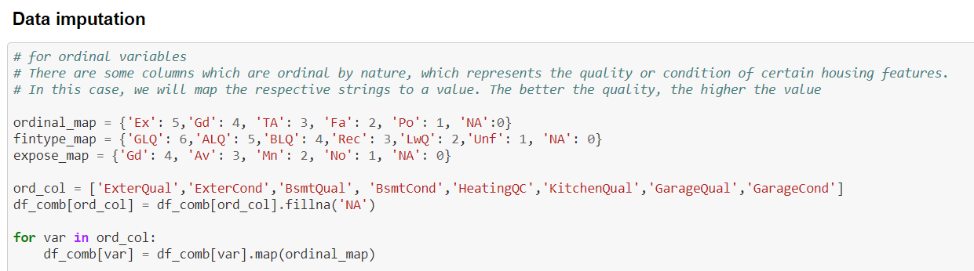
Data imputation
According to the quality standard, I have added a map to change a few of categorical features into numerical features
After imputing the NaN values the data for then sent to various machine learning algorithms
The best performance algorithm was chosen

Slide 11
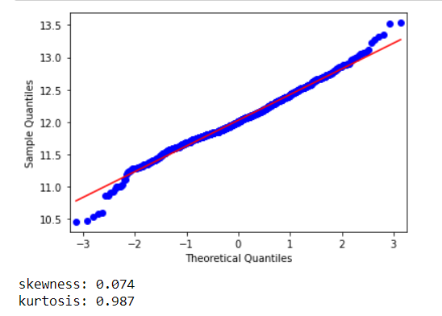
Skew and kurtosis of target variable (Sale price)

Slide 12
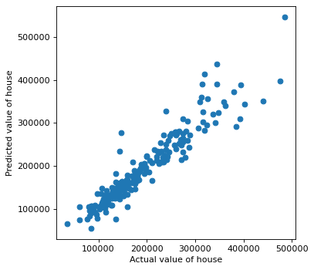
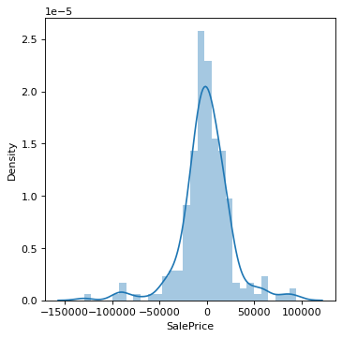
Final model XGB Boost after hyper parameter tuning

Slide 13
Conclusion
House prices are very complex
Predicting of the house prices is a complex task, here we have used complex machine learning algorithms to help us solve the problem.
We have used the MAE as the main metric.
XGB boost algorithm works best for this particular data set, hyper parameter tuning was performed and optimal parameters were found.
Our MAE value was 17696

